Slide 1
Midterm 1 Review
We’ll be starting at the 10 minute mark

Slide 2
Agenda
Python Identifiers
Built in data types: int, float, str, bool
Operators
Functions
Control-flow statements
if/ elif / else statements
while statements

Slide 3
Python Identifiers
Which of the following is not a valid name in Python?
x2
man_of_war
_Beverly_Hills_90210
Medusa_
None of the above

Slide 4
Boolean Values
The variable dollars is assigned the value 8. Which expression produces the value True?
8 = dollars
dollars == 8
Dollars == 8
dollars != 8
8 >= dollars

Slide 5
Type Casting
What is the output of int(72.5)
‘72’
72
73
72.0

Slide 6
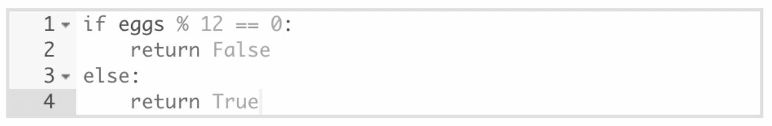
if-statements
Select statements equivalent to the statements above:
return eggs%12 == 0
return not eggs % 12 == 0
return not(eggs % 12 != 0)
return eggs % 12 != 0

Slide 7
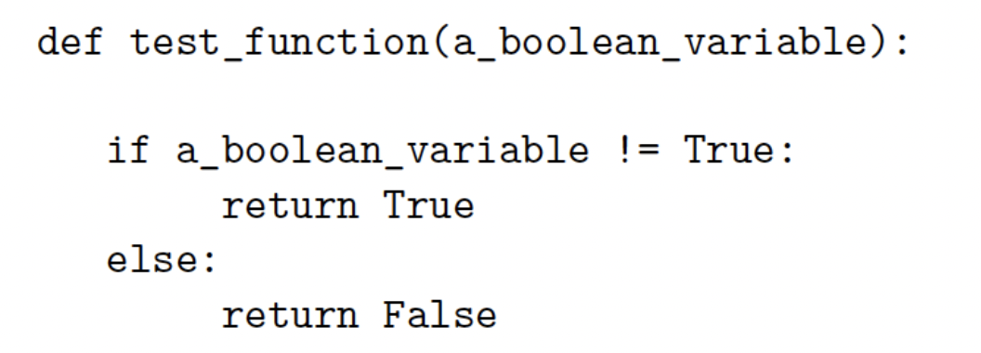
Functions and if-statements
Which of the following statements can replace the body of test_function and produce the same result?
return False
return a_boolean_variable
return True
return not a_boolean_variable
None of the above

Slide 8
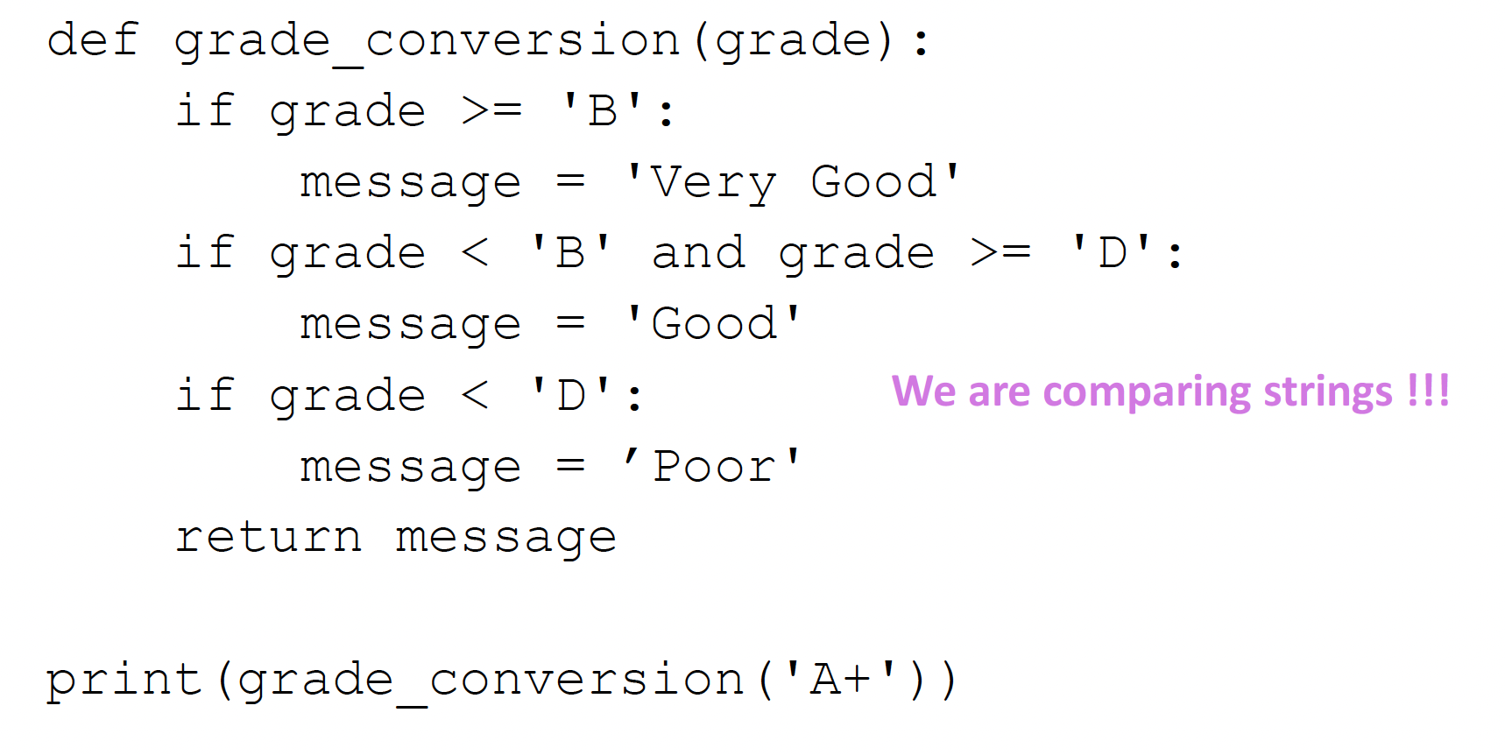

Functions and if-statements
What is the code output?
“Poor”

Slide 9
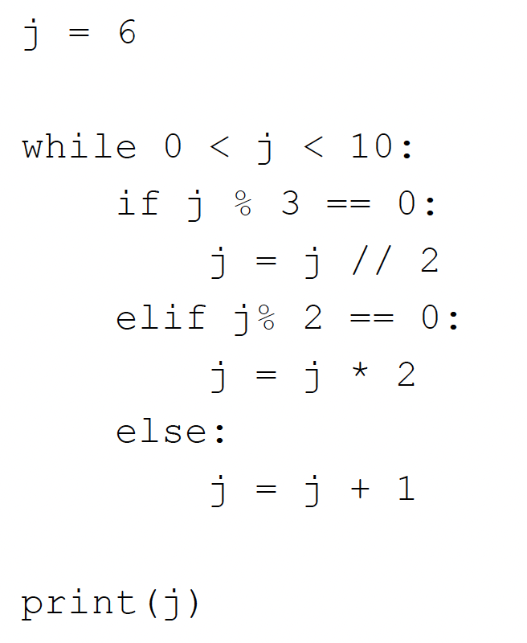
while loops and if statements
What is the code output?
16

Slide 10
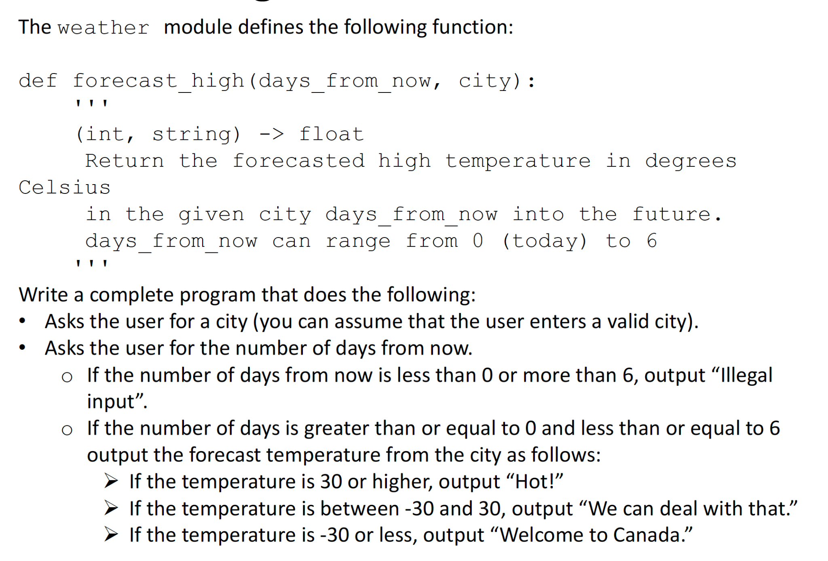
Coding Problem #1

Slide 11
Coding Problem #2
In the old days, you needed to roll a die physically for your board games - not anymore! With the help of random library and the randint() function we can generate numbers from 1 - 6.
Write a small program that will:
- keep asking a user if they want to roll the dice. If the user says ‘yes’, keep playing, otherwise stop
- roll the dice by generating a number, print this value
- when the user is done playing, tell them how many times they rolled the die total
Hint: set the dice variable to random.randint(1,6)

